Slide 1

L’Oréal – Discussion Materials
September 2024

Slide 2
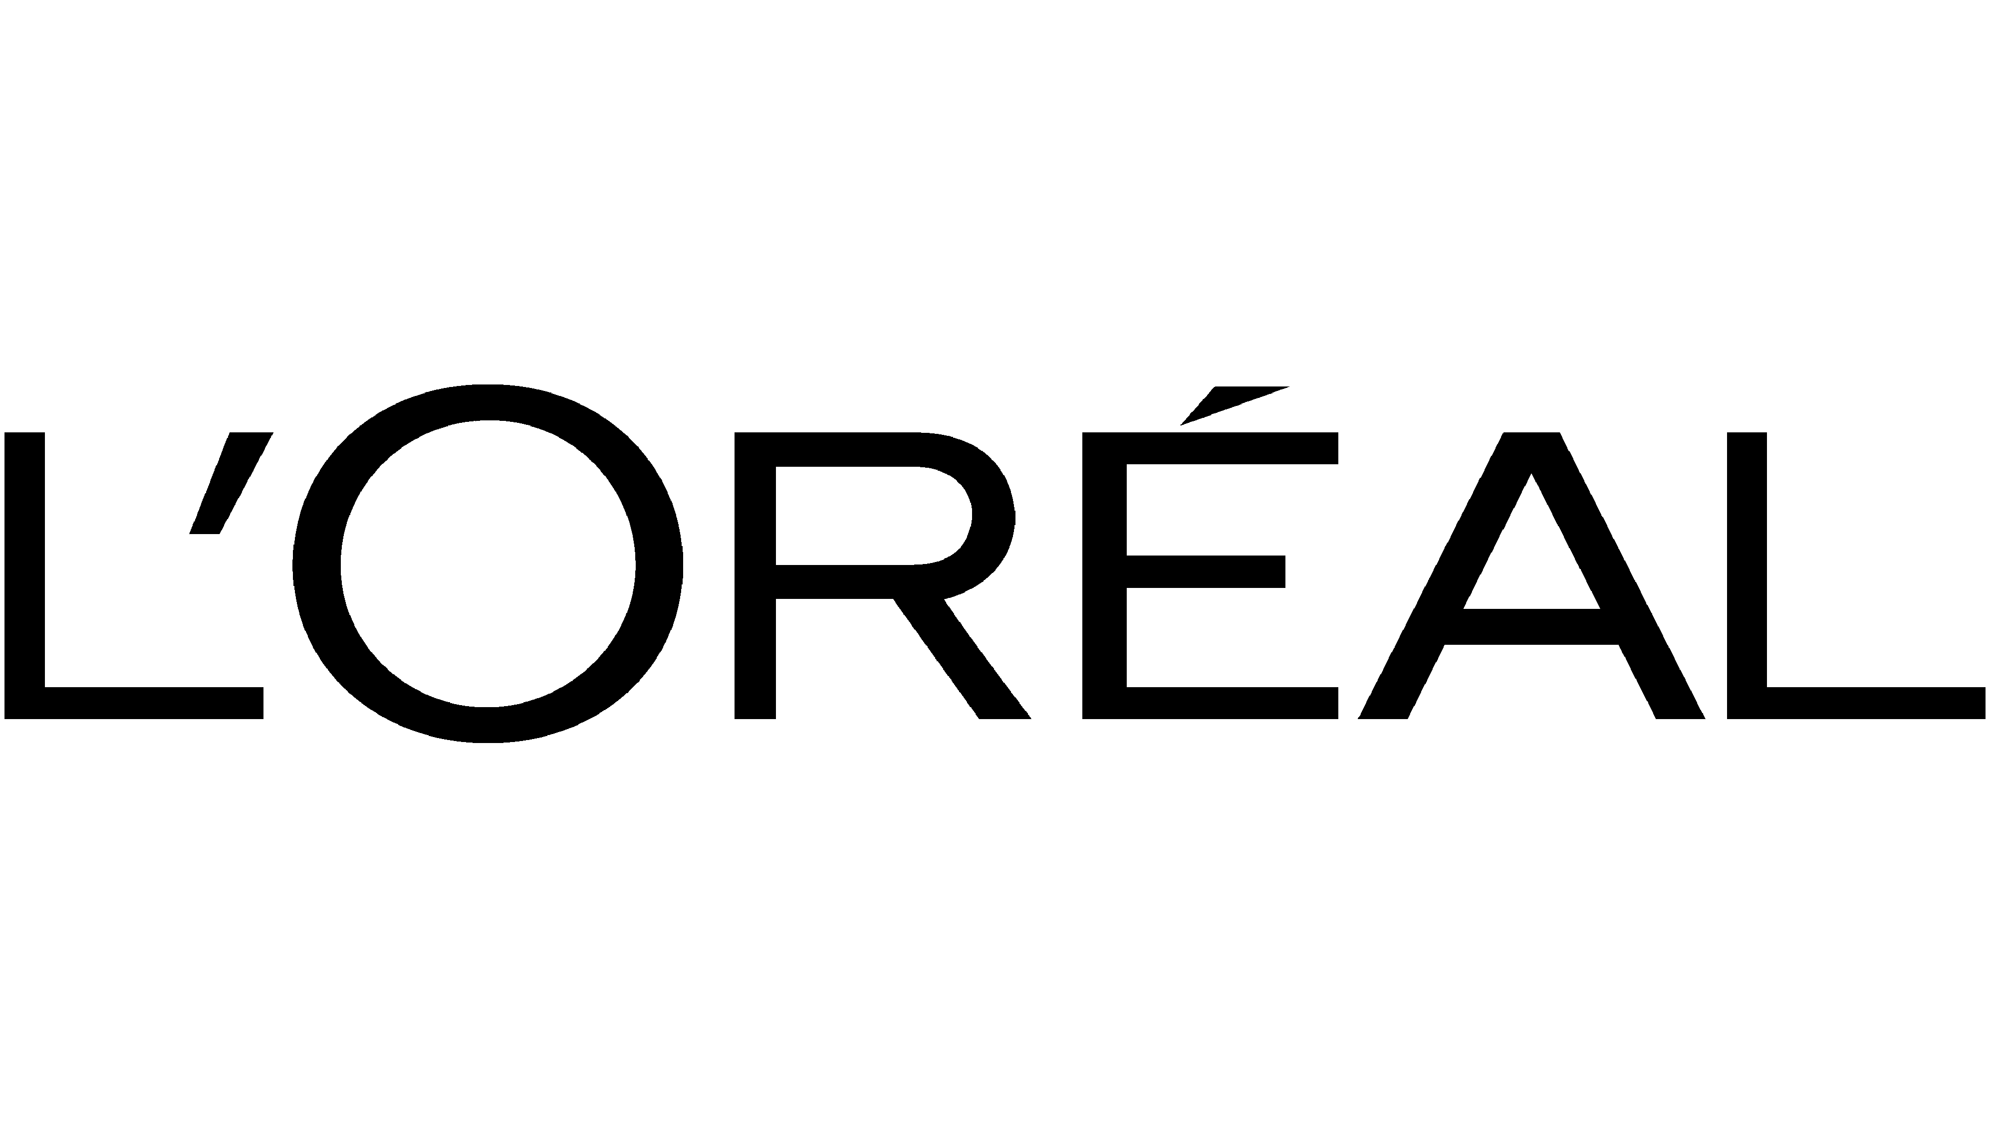



L’Oréal, No.1 Beauty Group worldwide
L'Oréal is the global leader in beauty, seamlessly blending innovation and sustainability to create products for every consumer.
Company’s description
L’Oréal Business Overview
L'Oréal was founded in 1909. The company is a global leader in the beauty industry, listed on the CAC40 with a market capitalization of €195,04bn (as of 13/09/2024). The company in headquarted in Clichy, France.
L’Oréal specializes in hair color, skincare, sun protection, makeup, perfume, and hair care. L'Oréal is known for its strong commitment to research and innovation.
L'Oréal has made significant sustainability commitments, including a goal to achieve carbon neutrality by 2025
L'Oréal business is structured into four key divisions each focusing on different market segments to meet diverse beauty needs worldwide.
L'Oréal Luxe
Professional Products
Consumer Products
Active Cosmetics
+37 Brands +90k employees + 6.5 bn of products sold
Recent Devlopments
Geographical footprint
Acquisition of Mugler and Azzaro
Launch of the fourth Employee Share ownership
2020
2021
2022
2023
2024
Acquisition of a 10% stake in Galderma
Purchase by L'Oréal of 4% of its own shares held by Nestlé
Acquisition by L'Oréal of AESOP, an Australian luxury cosmetics brand, for US$2,53 billion

Slide 3
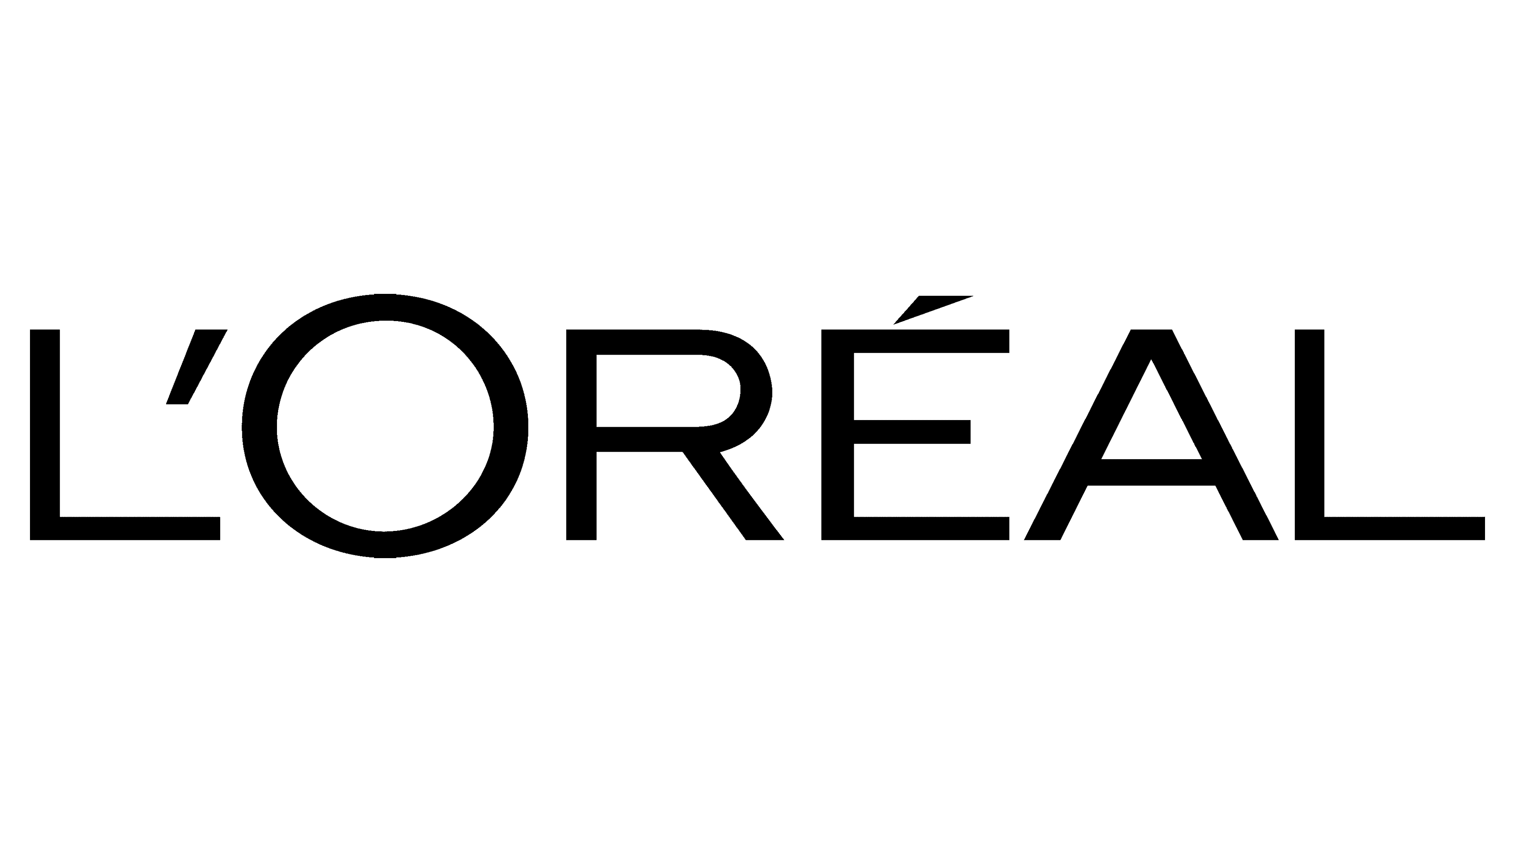



L’Oréal - Financial Performance
L'Oréal share price compared with the CAC40 index
Evolution of historical financial performance
CAC40
Sales breakdown by division
Shareholding structure & Management
Nicolas Hieronimus CEO
€41.18bn
Christophe Babule CFO
Jean-Claude Le Grand Head of HR

Slide 5
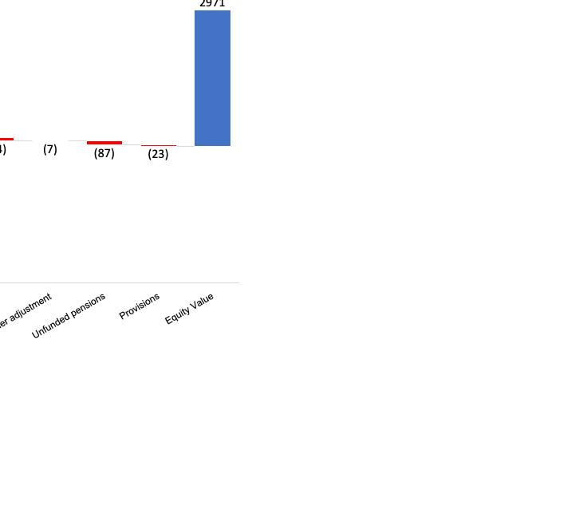
Valuation
We have presented below a multi-criteria valuation summary
Football Field Valuation
Bridge
Current share price = €608.10
Sources: FY22 annual report, H1 23 report, company website
Notes: (1) Latin America
(2) Northern & Eastern Europe
5

